Slide 1
EE207 P-N Junction Diode
S. Lodha
From: R. Pierret, Semiconductor Device Fundamentals

Slide 2
P-n Junction Equilibrium Band Diagram
At equilibrium

Slide 3
P-n Junction Electrostatic Picture
At equilibrium
Built-in potential, electric field and charge density

Slide 4
Built-in potential

Slide 5
Depletion Approximation
Simpler solution to Poisson’s equation

Slide 6
Quantitative electrostatics

Slide 7
x_{n}, x_{p}
Continuity of E and V at x=0
No sheet charge or dipole at x=0

Slide 8
Applied voltage V_{A}
Under low level injection and low R Ohmic contacts, V_{A} drops across the depletion region

Slide 9
Electrostatics
Replace V_{bi} with V_{bi}-V_{A}

Slide 10
Electrostatics
Depletion width, electric field and potential drop increase if V_{A}<0 and decrease if V_{A}>0

Slide 11
Band diagrams
Forward bias (V_{A}>0
Reverse bias (V_{A}>0)
Quasi-fermi levels not drawn in depletion region

Slide 12
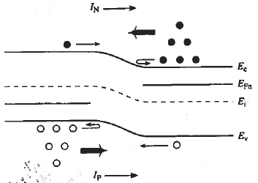
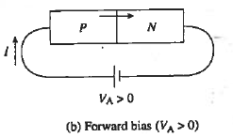
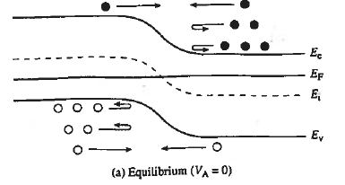
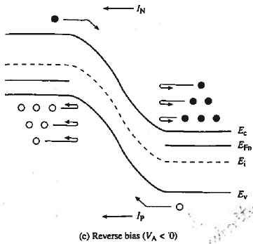
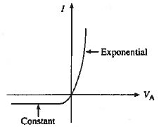
Current flow (Band diagrams)

Slide 13
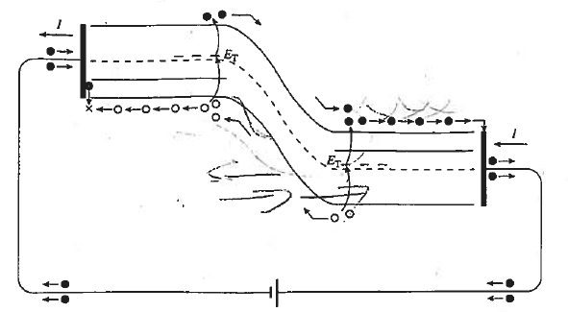
Full Circuit Picture
Net current is constant, Jn(x) and Jp(x) vary with x
Steady state, dn/dt = dp/dt =0

Slide 14
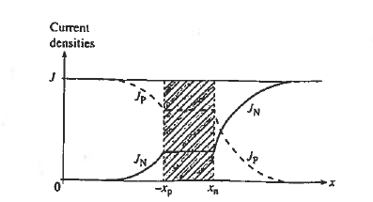
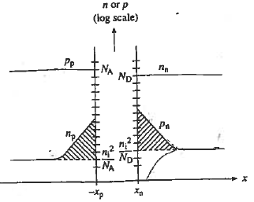
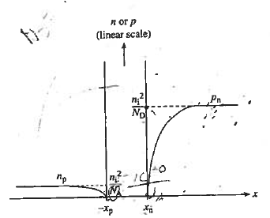
Current and carrier densities
Forward Bias
Reverse Bias

Slide 17
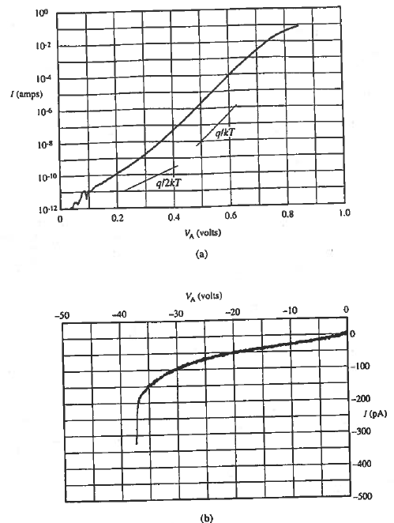
Experimental I-V
Break down at high RB
Higher than expected currents at low FB and RB
Non-saturating RB current
Slope decreases at high FB

Slide 18
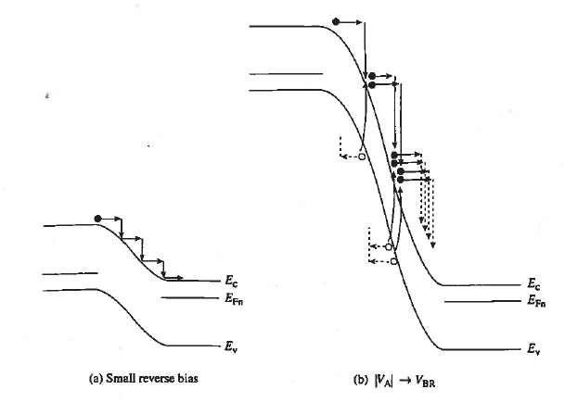
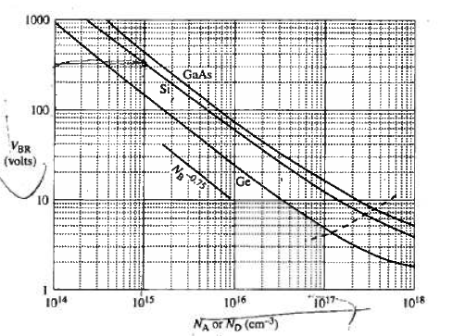
Avalanche Breakdown
Lower doping gives higher VBR
Larger bandgap gives higher VBR
Higher T requires higher VBR

Slide 19
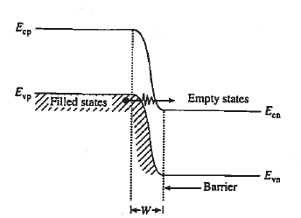
Zener Breakdown
Higher reverse bias V increases number of electrons and available states
Higher doping decreases tunneling width

Slide 20
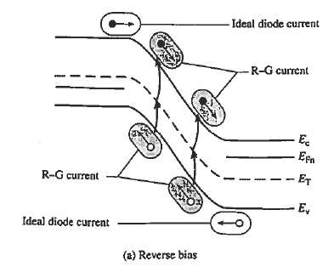
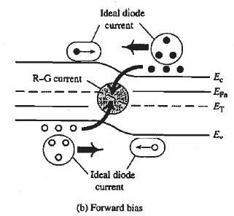
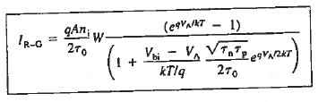
R-G current
Note dependence on W (RB) and n_{i}

Slide 21
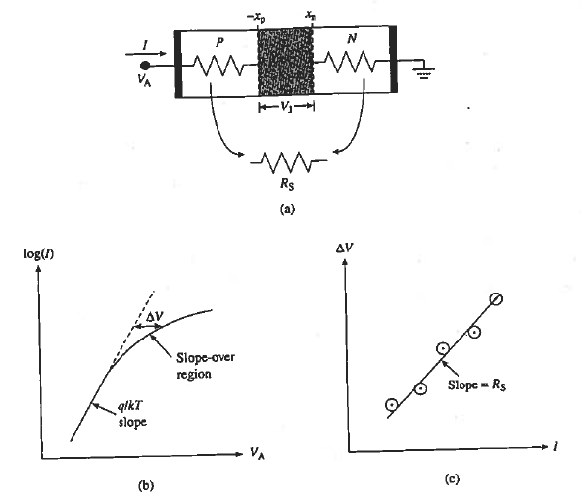
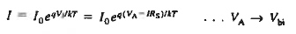
Series Resistance

Slide 22
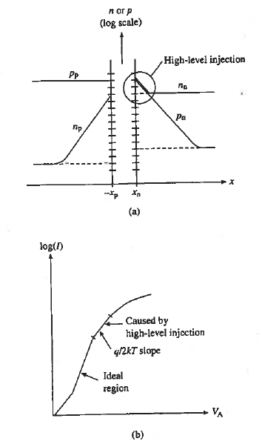
High Level Injection
Typically not seen, since Rs effect kicks in much before HLI sets in

Slide 23
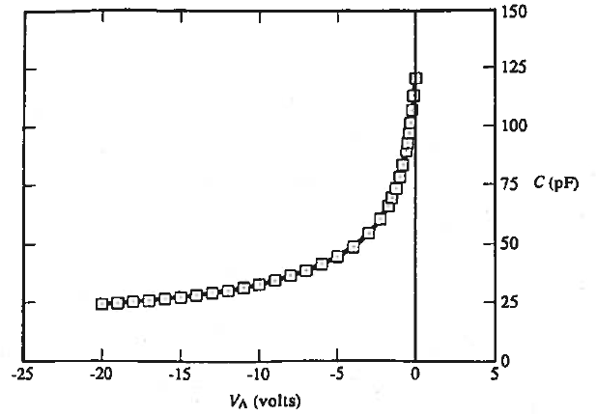
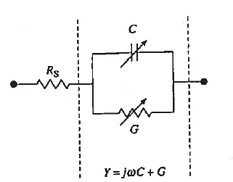
Reverse-bias admittance
G is approx zero
Variable capacitance in reverse bias due to majority carriers

Slide 24
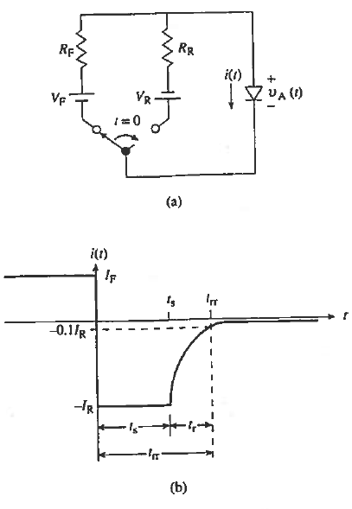
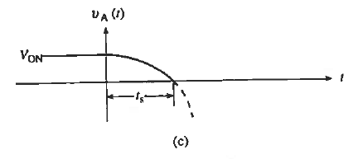
Transient off response
Current flips to large –ve current
Storage time is most important
Depends on I_{F}, I_{R}, τ_{p}

Slide 25
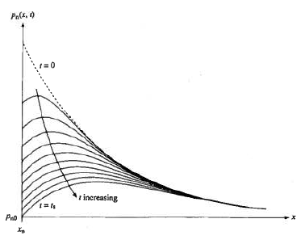
Transient-off
Excess Minority charge is removed through recombination (limited by τ_{p}) or current flowing out (limited by I_{R})

Slide 26
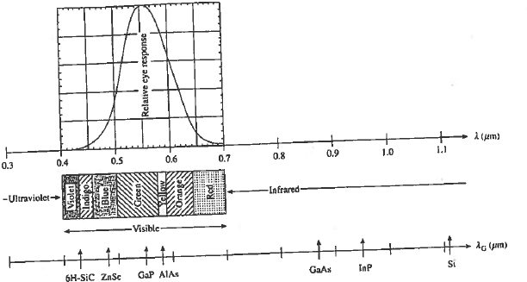
Optoelectronic diodes
Wavelength (um)=1.24/E_{G}(eV)

Slide 27
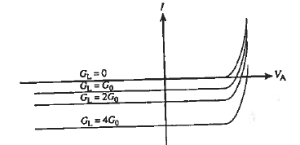
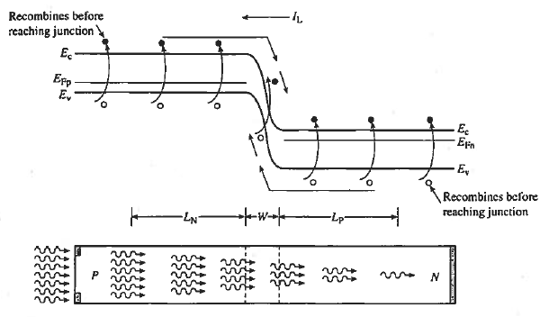
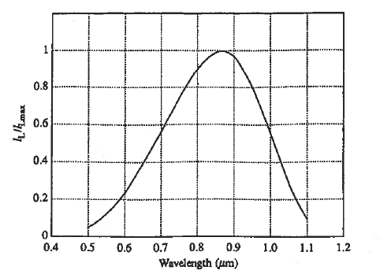
PN jn photodiode
Generation of reverse current

Slide 28
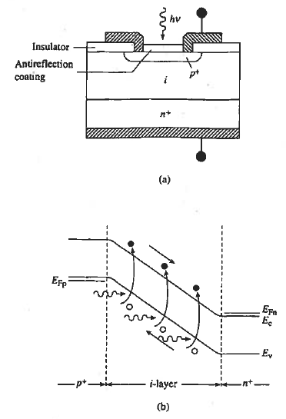
P-i-n photodiode
Fmax high (~GHz) since carriers are quickly swept away by e-field
Response tuned by width of i-layer

Slide 29
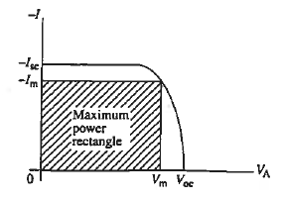
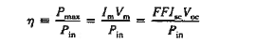
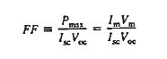
Solar cells
Energy loss and cost are the main drivers of solar technology (price / watt)

Slide 30
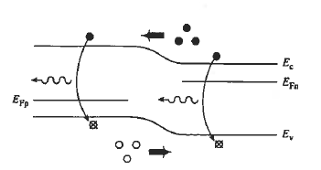
LEDs
Band-band recombination in forward bias
Three requirements:
Direct Band gap
1.77 eV< EG < 3.1 eV
Ability to form pn junctions

Slide 31
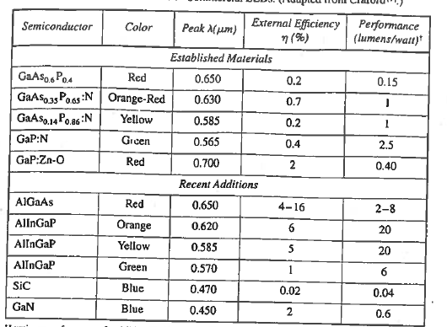
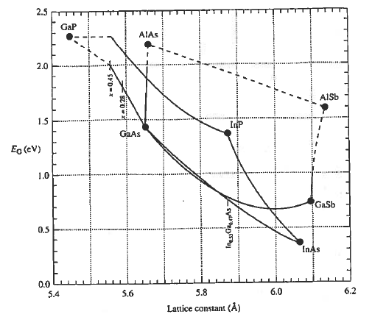
Commercial LEDs

